Slide 1
Acquisition, Access to, and Preservation of eScores: A new model for the Library-Music Publisher Collaborations
Joint meeting of the NYSO, NEMLA,
and SQACBM
Montreal,
McGill University, November 8, 2018
Houman Behzadi and Kyla Jemison, University of Toronto
Brian McDonagh, Plangere Editions and University of Toronto

Slide 2
Outline
Importance of devising eScore acquisition models
Logistics of the UTL-Plangere eScore project
Introducing Plangere Edition
Vision behind the publication and sale of eScores
Description of electronic scores without publisher metadata
Notes:
Good afternoon, everyone! I’m please to be here with my colleagues Kyla Jemison and Brian McDonagh to talk to you about the work we’ve been doing to acquire, preserve, and provide access to the eScores of the Plangere Editions.
To provide an overview of our presentation, first I’ll talk about the importance of finding new ways of acquiring eScores, be it from self-published composers or established music score publishers; I’ll then talk about the pilot project that the University of Toronto Libraries and Plangere Edition are working on to establish a model that aims to provide a response to a tangible gap in music library’s collections.
Following my portion, Brian will talk about Plangere Editions, providing a Canadian music publisher’s standpoint on the publication and sale of eScores.
And lastly, Kyla will speak about the challenges associated with describing electronic scores without publisher metadata. In the end, we’ll have time for your questions and comments.

Slide 3
“We need new routines--appropriate to the material and the moment--to identify, select, acquire, and process the work of a growing cohort of composers who embrace this mode of production and dissemination.”
Underwood, K. (2016). Scores, libraries, and web-based, self-publishing composers. Notes, 73(2), 205+. Retrieved from http://link.galegroup.com.myaccess.library.utoronto.ca/apps/doc/A472473212/AONE?u=utoronto_main&sid=AONE&xid=d945987e
Notes:
In his article titled Scores, libraries, and web-based, self-publishing composers, Kent Underwood talks about an increasing body of self-published electronic scores, most of which are available for purchase on the composers’ personal website, and in some cases housed on an established music score publisher’s website. Underwood’s examination OCLC records for a several hundreds of these self-published works illustrate that a portion of this repertoire is not being collected by libraries. As a result, he mentions: “We need new routines--appropriate to the material and the moment--to identify, select, acquire, and process the work of a growing cohort of composers who embrace this mode of production and dissemination.”
As a collections librarian, I’ve gotten many requests to purchase works that are available as PDF files on the composers’ or publishers’ websites. At times, these works are available as electronic-only, which produces a number of challenges for music libraries. At my library, we cannot really acquire a digital item without signing a license that governs the use of that item. Some of our colleagues at other libraries have been successfully purchasing, printing, and binding the materials, which is still a problematic solution for us due to, first, copyright issues, and second, lack of any established workflows (and resources) for the acquisition, printing and processing such items.
For the above-mentioned reasons, it’s now several years that I have been thinking about potential solutions that would enable us to legally acquire and provide access to eScores. And of course I’m not alone in this venture. This past July at the IAML conference in Leipzig, I met with the representatives of two aggregators who are developing platforms for hosting packages of eScores, to which libraries can subscribe. Each aggregator has secured relationships with a number of well-established music publishers and is currently hosting a fairly modest but growing number of works on their platforms. Looking at the developments of the eBooks market, one cannot help but notice that there is also huge untapped potential in the eScore business. Personally, I do see the growing need for eScores at our institutions and I wonder when and how the music score publishing industry will move to a hybrid model of ownership vs. access, much like what we see in the book and journal publication industries.

Slide 4
Notes:
I believe it was a couple of year ago that Brian approached me to ask if the library would be interested in the acquisition of the electronic version of what he has published in print. Being aware of our collective challenges in this area, I immediately saw this as a worthwhile undertaking for the following reasons: 1) through collaboration with an important publisher of Canadian art music, who also happens to be a colleague at the University, we would be collecting and preserving repertoire that is or published in Canada; and 2) through a pilot project with Plangere Editions, we could establish the logistics and workflow required to acquire and give access to digital content without publisher metadata. Once the infrastructure for such work is in place, we could explore collaborations with other publishers or institutions, like the Canadian Music Centre, which provide dissemination and publishing services for Canadian composers.

Slide 5
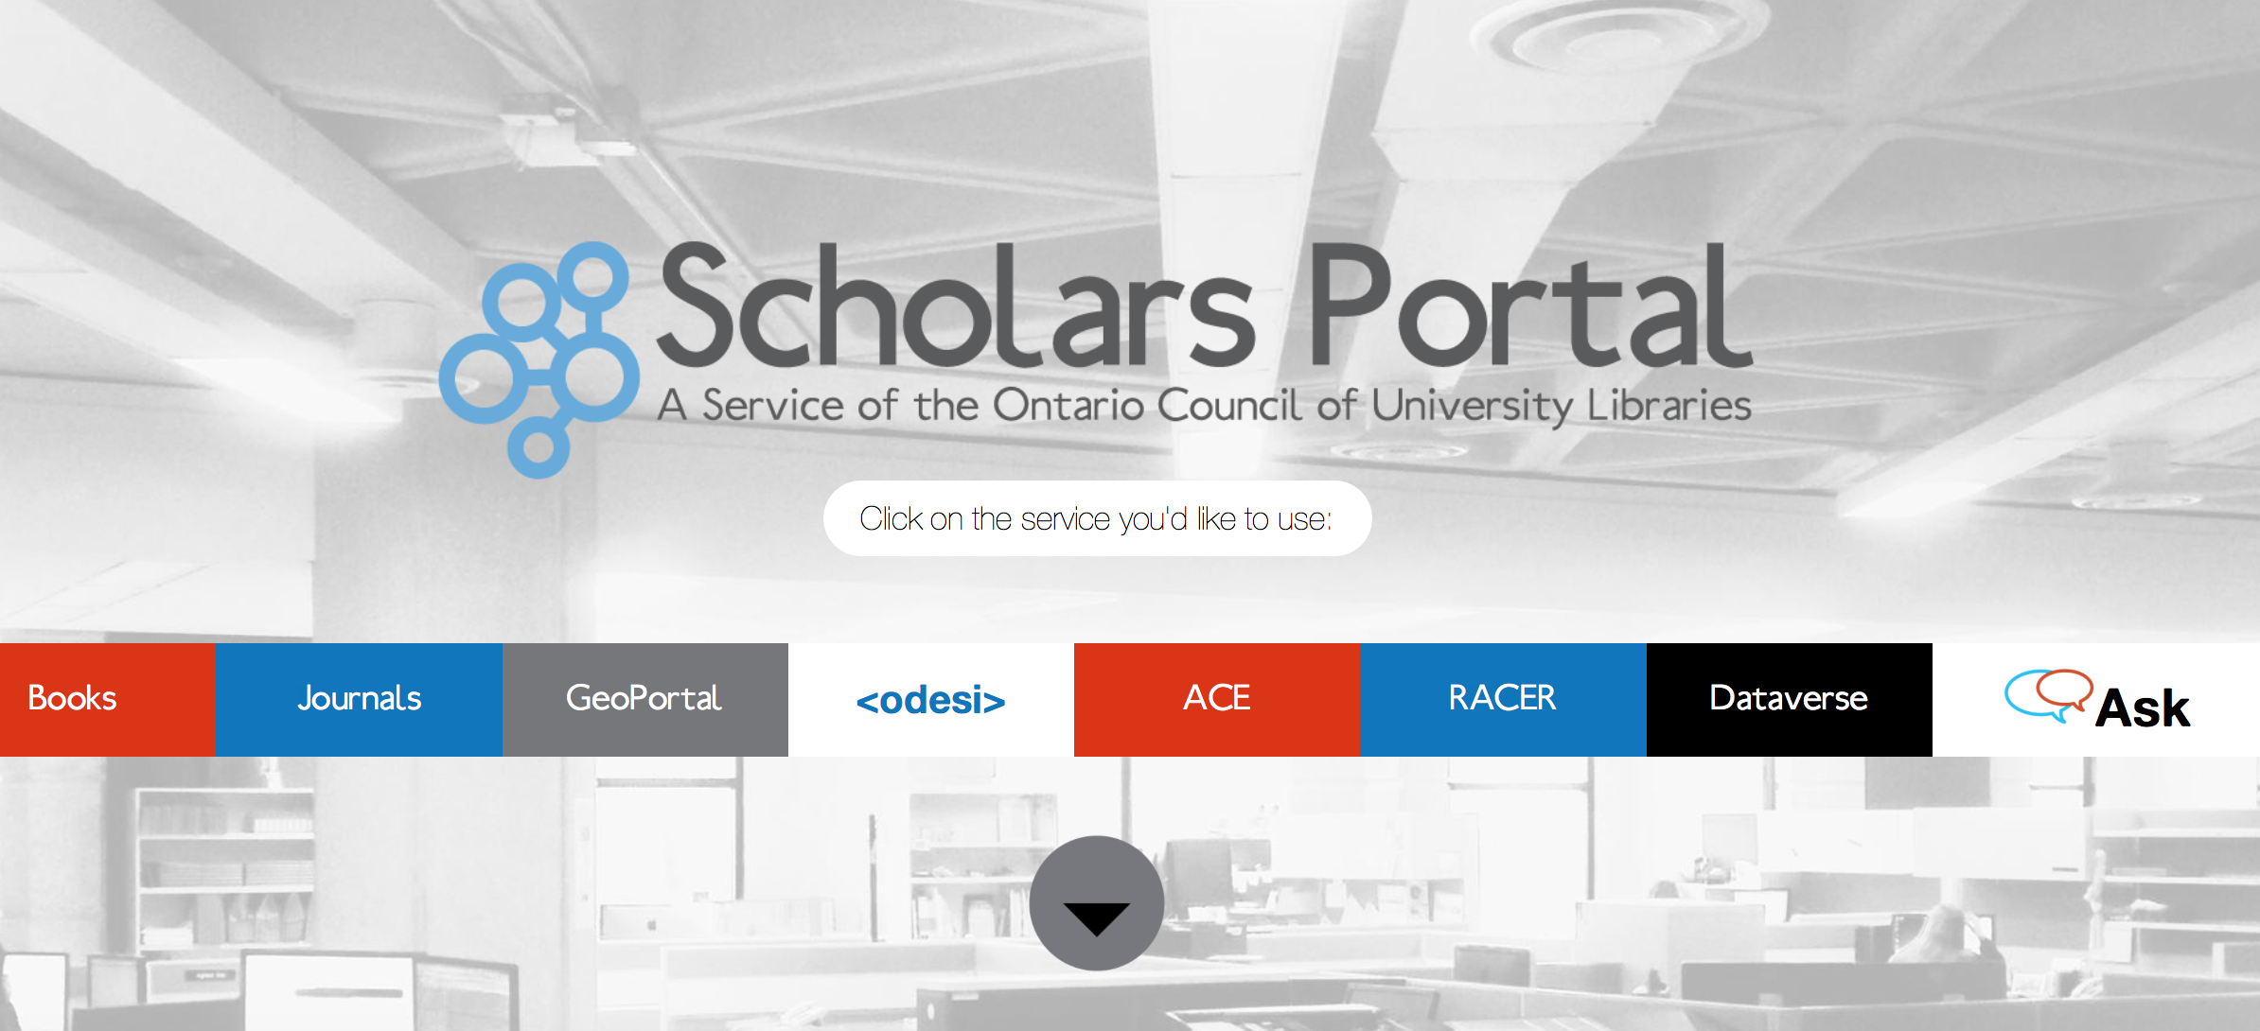
Notes:
Description of Scholars Portal Services and how we’re going to use their new eBook platform to host the eScores.
See their website for more information.

Slide 6
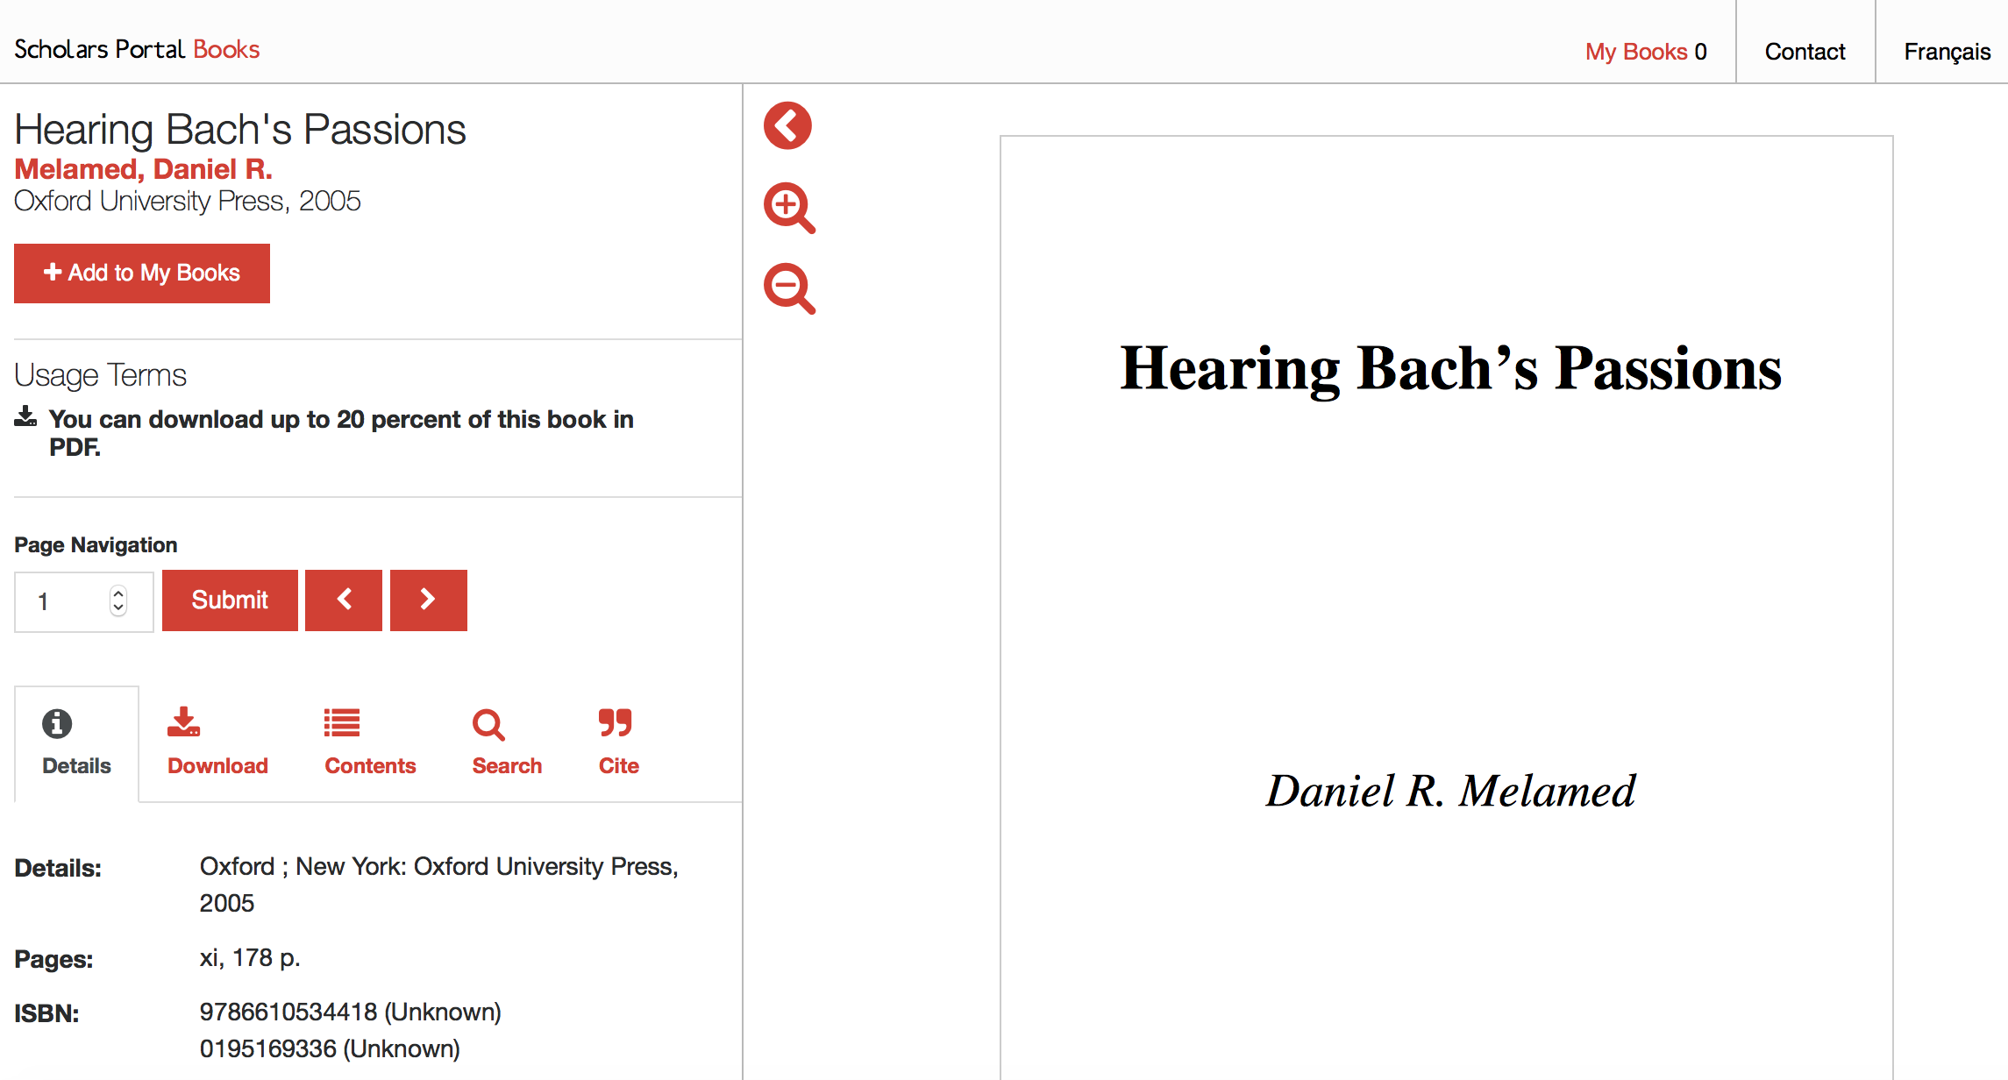

Slide 7
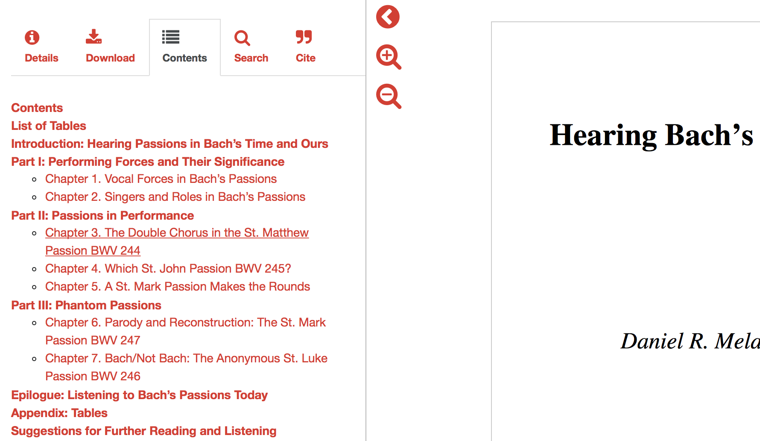

Slide 8
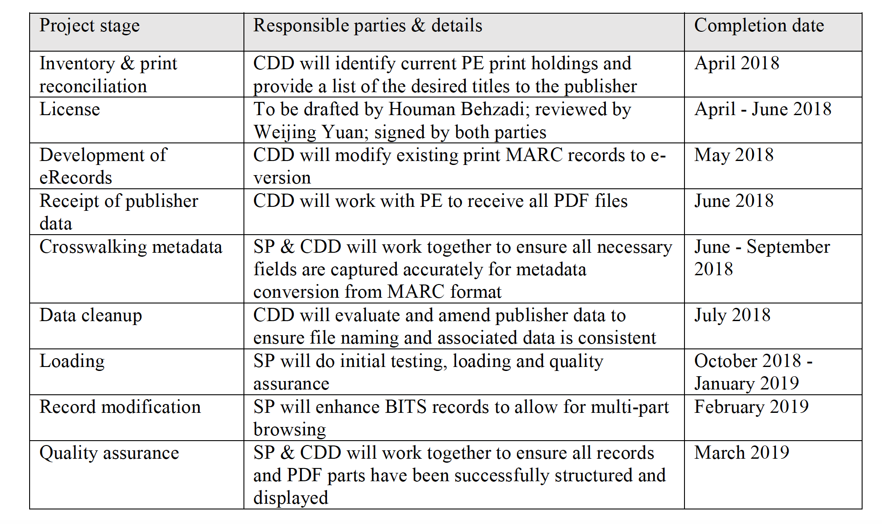
Notes:
The project team received a UTL Chief Librarian Innovation Grant to fund the purchase of the Plangere Edition’s backlog (240 titles in the first phase). This chart shows our initial project steps and timelines. Due to a number of unforeseen issues, our timelines have changes, but we remain hopeful that we’ll meet the March 2019 deadline regardless.
CDD: University of Toronto Libraries Collection Development Department
SP: Scholars Portal
PE: Plangere Editions

Slide 10
Metadata for eScores
Kyla Jemison
Notes:
I was brought onto this project to deal with one of the big issues with collecting and providing access to escores - the metadata. Unlike most eresources in Scholar’s Portal, this collection had minimal publisher-supplied metadata - we received a spreadsheet with title, composer, instrumentation, and ISMN columns. That’s not nearly enough information to construct a catalogue record, so there was quite a bit of work to do.
It is especially important to have accurate metadata for this project because music is a new format for Scholar’s Portal - we have to think about questions like What are the differences between a physical score and a digital score, and how do we indicate that in a catalogue record? What are the differences between an escore and an ebook? The University of Toronto Libraries had acquired and catalogued many print scores from Plangere Editions already, so we decided to use those catalogue records as a starting point and focus on adapting them to reflect the change in format.
In her inventory process, our student employee, Hannah Brown, added a column to the metadata spreadsheet indicating the print version’s catalogue key number - a unique identifier for each record in our collection, if there was one.

Slide 11
Changes
Notes:
Working with [Marlene or Jordan or Sarah?], I created a file containing just these records. Using MARCedit, a metadata editing program that allows us to create and manipulate MARC records, I made a few batch changes to this file.
First, I deleted all the fields that were unnecessary for the erecords, including OCLC numbers and 9xx fields (Sirsi-provided information about location, status, etc. of the item). Then I moved onto more substantive changes, two of which I’ll show here.

Slide 12
300
Physical scores
1 score (70 pages) ; 30 cm
1 score (12 pages) + 4 parts ; 36 cm
eScores
1 online resource (1 score (70 pages))
1 online resource (1 score (12 pages) + 4 parts)
Physical description
Notes:
Among those changes was the 300 field, the physical description. For print scores, the 300 provides a structured way to describe the physical properties of the item - “1 score (70 pages) ; 30 cm” or “1 score (12 pages) + 4 parts ;|c36 cm”.
Looking at examples of other catalogue records for digital scores - primarily those from Alexander Street Press Classical Scores Library, they follow the format “1 online resource (1 score (## p.)).
So we went with that, and I batch-edited all files to remove the height measurement, and to append “1 online resource (“ to the beginning of every 300 field, and “)” to the end. Our discovery interface displays the physical description prominently in the catalogue, so this makes it immediately clear to users that this is an escore.

Slide 13
3xx
Physical scores
336 notated music$bntm$2rdacontent
337 unmediated$bn$2rdamedia
338 volume$bnc$2rdacarrier
eScores
336 notated music$bntm$2rdacontent
337 computer$bn$2rdamedia
338 online resource$bnc$2rdacarrier
Content, media, and carrier information
Notes:
It was also important to tell the system that these were escores, not physical scores. This can be communicated in the the 33x fields, which state the content, media, and carrier information in RDA records.
Because the content of the material has not changed - it is still, primarily, notated music, the 336 content field remain the same.
For print scores, 337 and 338 are unmediated and volume, respectively. These do have to change for eresources - the medium is no longer unmediated as it requires a computer to deliver the material to the user, and it’s no longer printed in a physical volume, it’s an online resource instead. All of these changes can be made at the batch level because they had to be fixed for every escore record.

Slide 14
Next steps
ISMNs
Links
License statement
Chapter-level metadata
Original records
Transfer to Scholar’s Portal
Documentation of workflow
Notes:
There are several steps yet to come for this project’s metadata. Once we have a completed list with all the new ISMNs, they will need to be added to the records. After Scholar’s Portal creates links to the online access point for the escores, those links will need to go in the records too. We also plan to add a note about the license for these escores in the 542 field. Scholar’s Portal has also requested chapter-level metadata - this won’t go in the MARC record, but it will allow them to correctly label scores and parts within the Scholar’s Portal environment.
A number of the escores we received were not also in our physical collection, but were very similar to print scores or other escores - for example, we had a record for the physical score of a song cycle for high voice, but not for medium or low. We received escores for all three versions. After the the batch editing process, the catalogue record for the high voice escore was complete. So, for the medium and low voice versions, I plan to duplicate the record for the high voice version, changing the record as needed.
Once we have created a complete file containing MARC catalogue records for all of these escores, they will be delivered to our colleagues at Scholar’s Portal, who will crosswalk these MARC records into BITS, their metadata format.
One of our goals for this project was to document a workflow that can be used in the acquisition and cataloguing of other escores. To that end, I have kept detailed notes and set up a task in MarcEdit that contains all the batch changes required to turn a physical score record into an escore record. These efforts will provide a precedent for future projects of this nature, and make it easier to demonstrate for vendors and other libraries how it can be done.

Slide 15
Thank you!
Notes:
Thank you! We are all available for any questions you might have.

